Slide 1
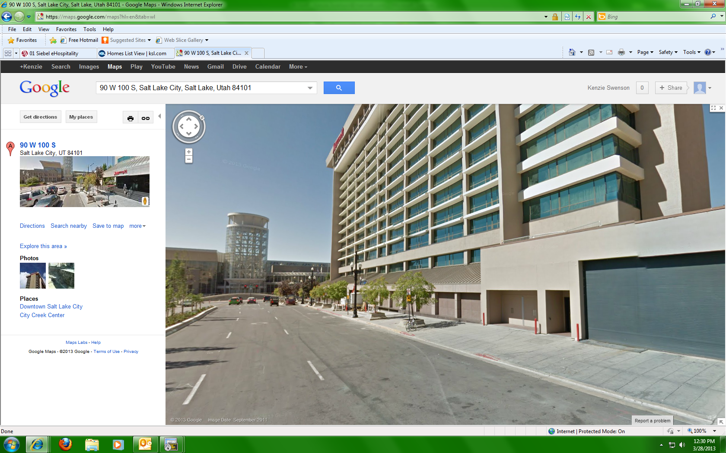

Front of Hotel
Oversized Vehicle Parking
Egress Doors
Loading Dock
Marriott at City Creek Loading Zone Directions
Please use State Street to access our loading zone located on 100 S and between Main Street and West Temple.
Our Loading dock is 12’6” tall 11’5’’ wide. Most semi trucks (13’6” tall) with detachable trailers will not fit in the loading dock. Most straight frame delivery trucks and some “city” trailers will. Trucks that will not fit in the loading dock must unload on 100 South through the egress double doors and it is usually required that they have a hydraulic lift gate to unload.
For large deliveries/pick ups please call our Loss Prevention team at 801-537-6080 to schedule a delivery/pick up time.
Oversized Vehicle Parking requires a city parking permit that can be ordered through your Event Manager. Parking permits cost $50 per day and require 3 days advance notice for ordering.

